Slide 1
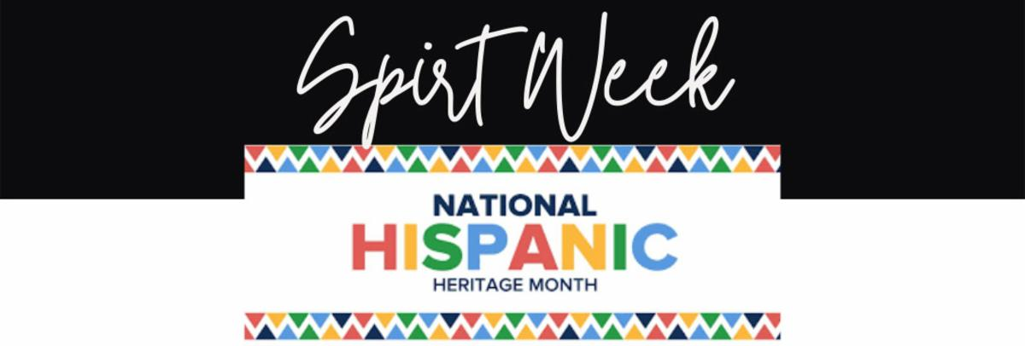
Monday October 11-No School
Tuesday October 12
  Soccer Jersey Day!
Wednesday October 13
  Switcheroo Day-Dress up like a teacher!
Thursday October 14
  Latin/Latinx/Hispanic pride day! Represent or dress up as your favorite Hispanic artist,athlete, musician or historical figure. (hats allowed)
Friday October 15
  Diversity Day-ALL CULTURES REPRESENT! Wear the colors that represent your own culture, flags, tshirts, jerseys, hats and accessories

